Slide 1
TITLE___CHILD_ABUSE__PERSPECTIVES_AND_OPINIONS_

Slide 2
Introduction
Child abuse is a serious problem that affects millions of children worldwide. It can take many forms, including physical, emotional, and sexual abuse, as well as neglect. In this presentation, we will discuss the different types of child abuse, their effects on children, and what we can do to prevent it.

Slide 3
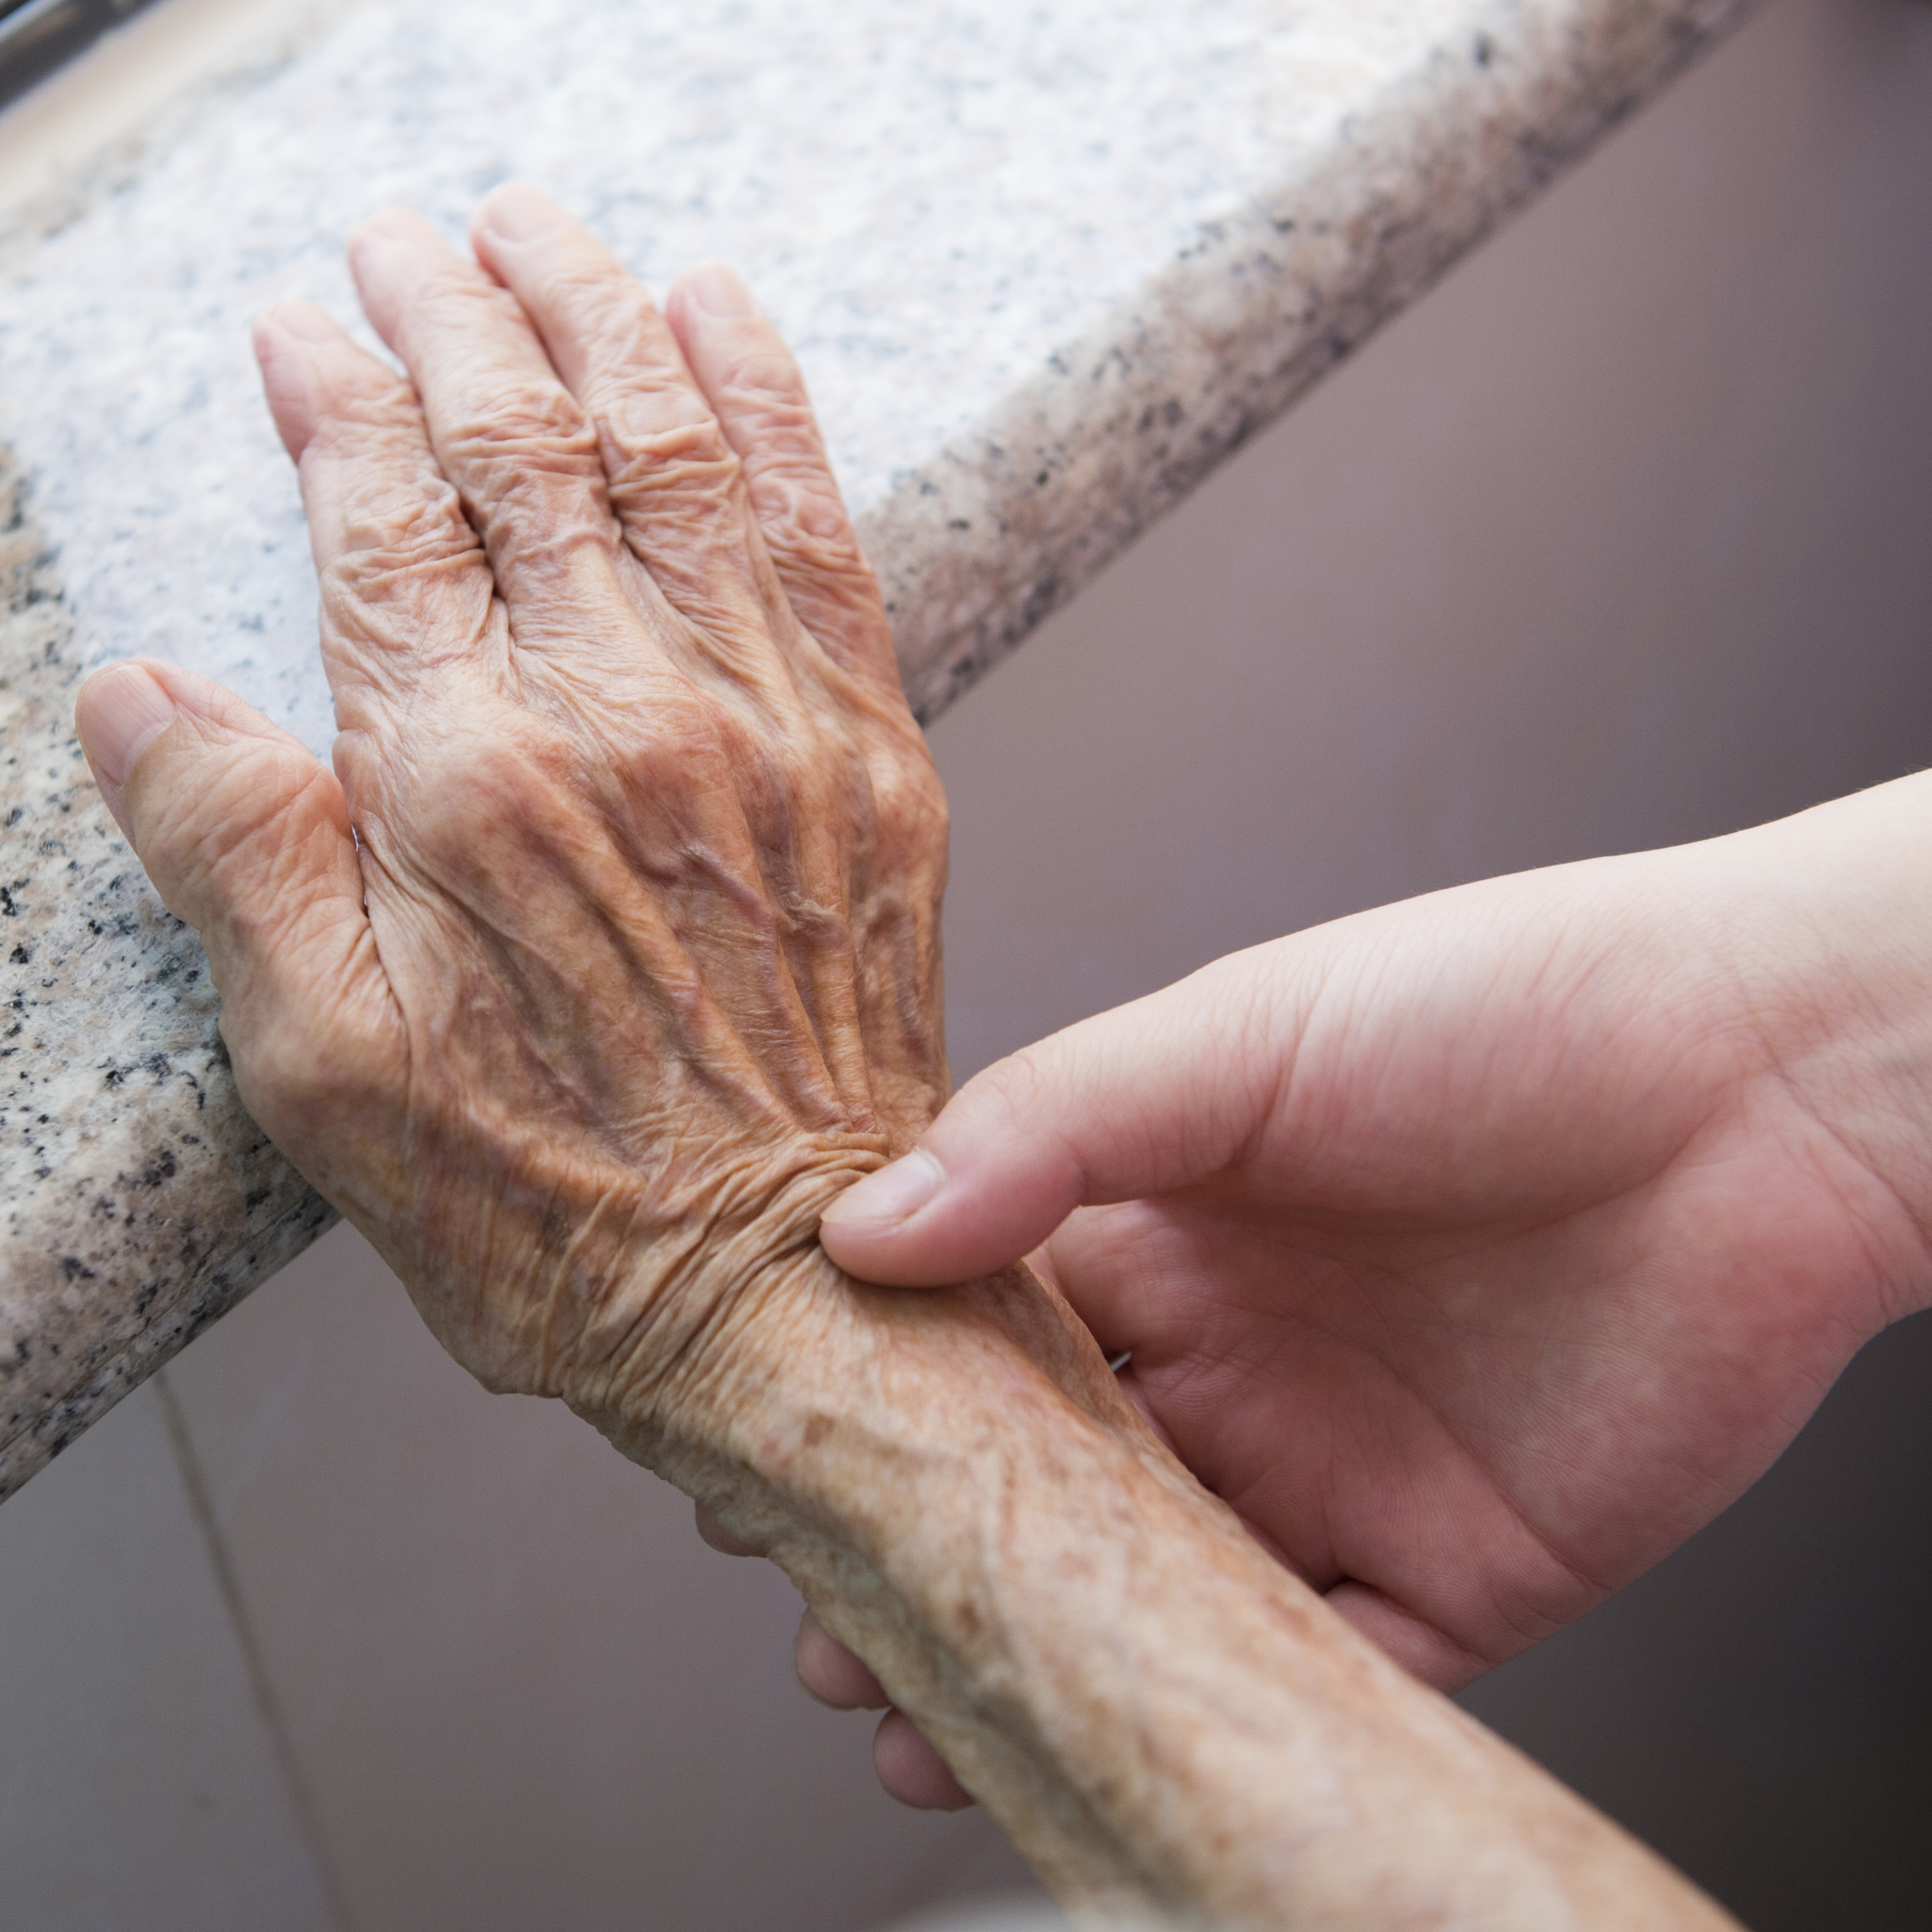
Physical Abuse
Physical abuse is any form of violence that causes harm to a child's body. It can include hitting, kicking, shaking, burning, or any other form of physical harm. Children who experience physical abuse may suffer from bruises, broken bones, and other injuries. They may also develop anxiety, depression, and other mental health issues.

Slide 4
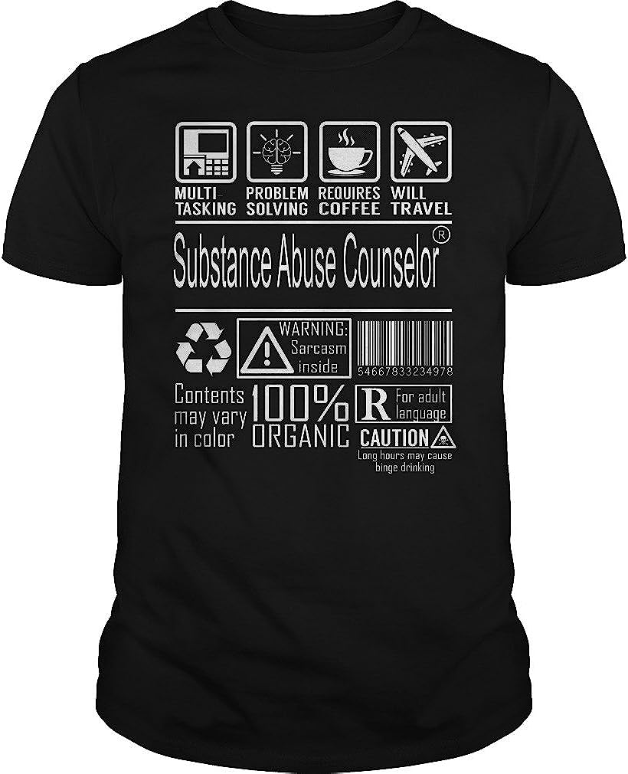
Emotional Abuse
Emotional abuse is any behavior that harms a child's emotional well-being. It can include verbal abuse, such as name-calling and belittling, as well as neglect and rejection. Children who experience emotional abuse may suffer from low self-esteem, depression, and other mental health issues. They may also have trouble forming healthy relationships later in life.

Slide 5
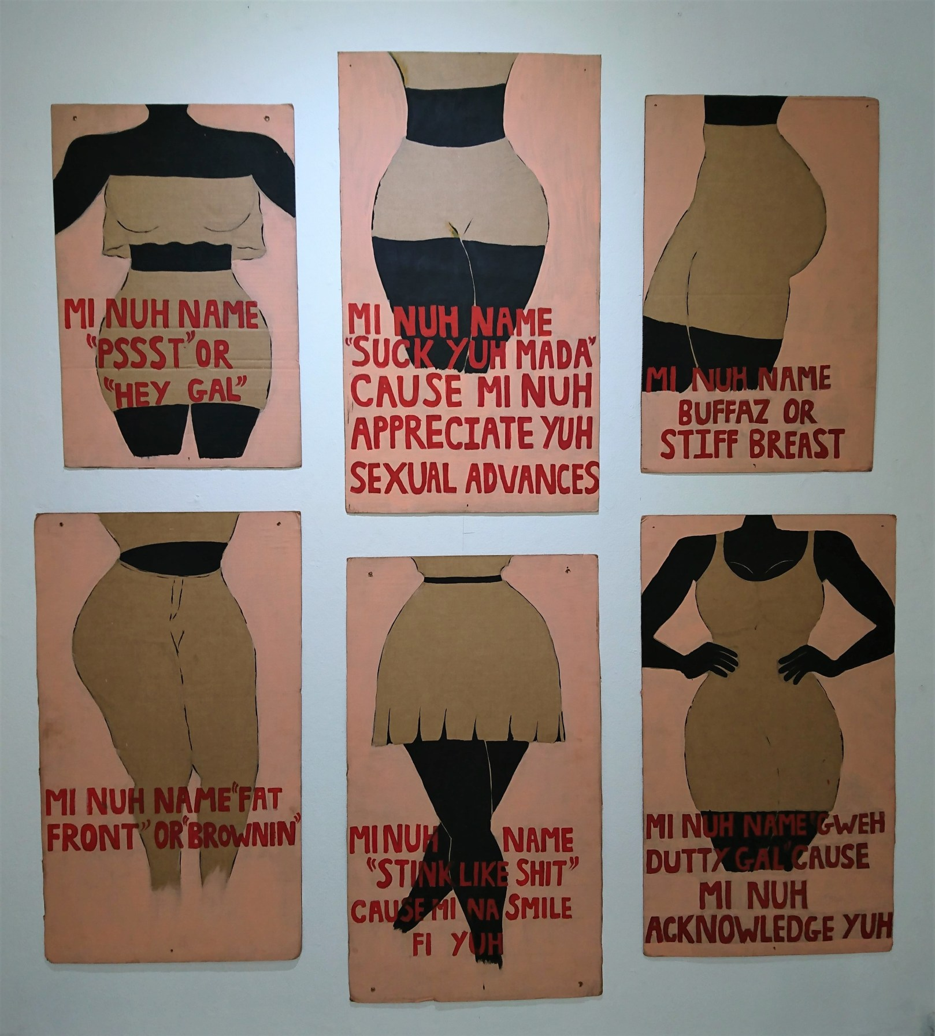
Sexual Abuse
Sexual abuse is any form of sexual activity that a child cannot give consent for or is not developmentally ready for. It can include touching, fondling, penetration, and exposure to sexual material. Children who experience sexual abuse may suffer from a range of physical and emotional problems, including anxiety, depression, and post-traumatic stress disorder (PTSD).

Slide 6
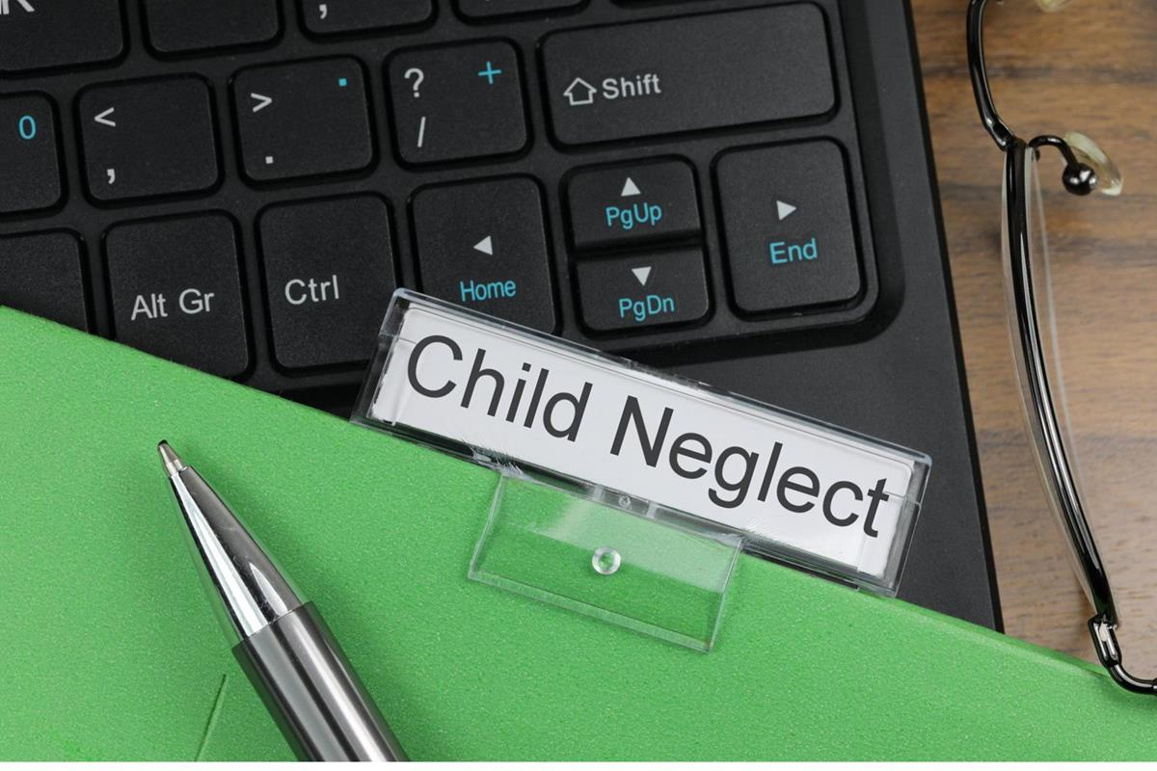
Neglect
Neglect is the failure to provide for a child's basic needs, such as food, shelter, and medical care. It can also include the failure to provide emotional support and supervision. Children who experience neglect may suffer from malnutrition, poor hygiene, and other physical health problems. They may also have trouble forming healthy attachments and relationships.

Slide 7
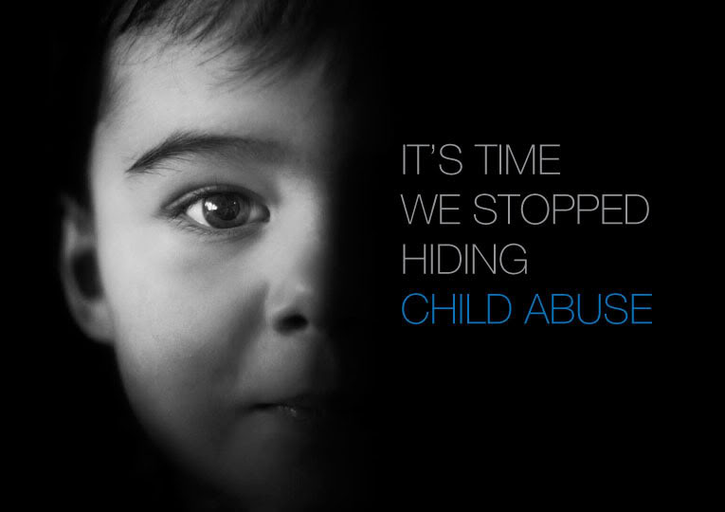
Effects of Child Abuse
Child abuse can have long-lasting effects on a child's physical and emotional well-being. Children who experience abuse may suffer from a range of problems, including anxiety, depression, post-traumatic stress disorder (PTSD), and other mental health issues. They may also have trouble forming healthy relationships and may be at risk for substance abuse and other harmful behaviors.

Slide 8

Reporting Child Abuse
If you suspect that a child is being abused, it is your legal and ethical responsibility to report it. You can report suspected abuse to your local child protective services agency or law enforcement agency. Remember, reporting suspected abuse can help protect children and prevent further harm.

Slide 9
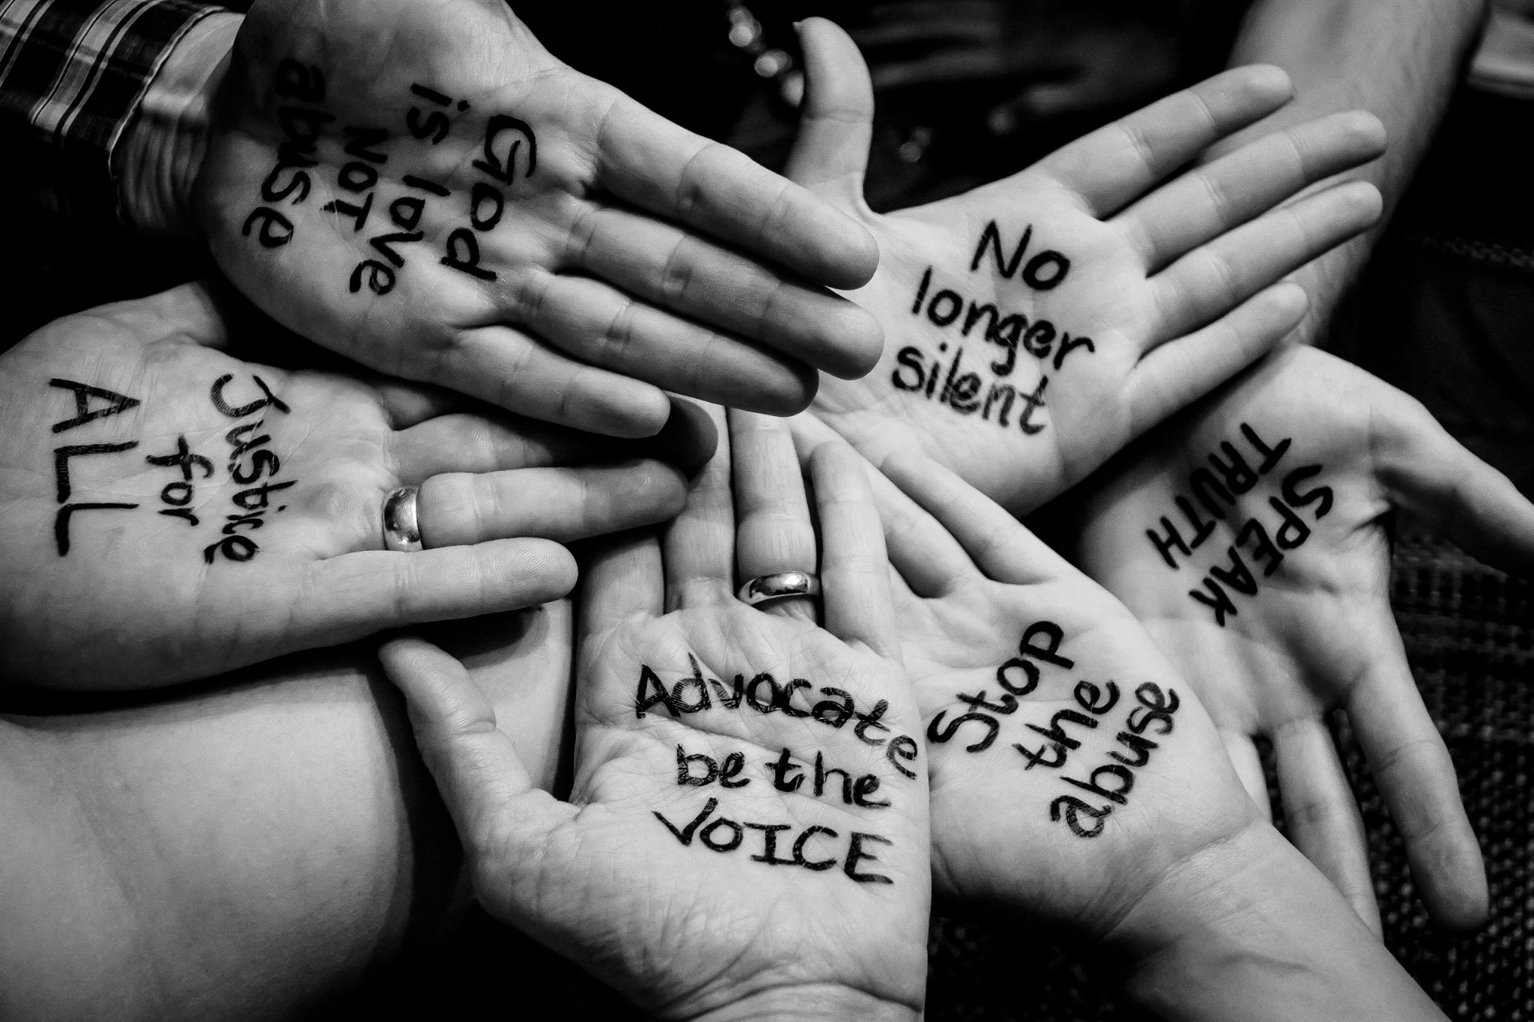
Preventing Child Abuse
Preventing child abuse requires a collective effort from individuals, families, and communities. Some steps you can take to prevent child abuse include providing support to families, promoting healthy parenting practices, and educating yourself and others about the signs and effects of child abuse.

Slide 10

Conclusion
Child abuse is a serious problem that affects millions of children worldwide. It can take many forms, including physical, emotional, and sexual abuse, as well as neglect. It can have long-lasting effects on a child's physical and emotional well-being. We all have a responsibility to protect children and prevent child abuse from happening.

Slide 11

Thank You
Thank you for taking the time to learn about child abuse and how we can prevent it. Let's work together to protect our children and create a safer and healthier world for everyone.

